Slide 1
Large-Scale SuperDARN observations of a Sub-Auroral Polarization Stream at Mid-Latitudes
L. B. N. Clausen (1), J. B. H. Baker (1), J. M. Ruohoniemi (1),
R. A. Greenwald (1), S. G. Shepherd (2), E. R. Talaat (3),
W. Bristow (4)
(1) Space@VT, Virginia Tech, Blacksburg, Virginia, USA
(2) Dartmouth College, Hanover, New Hampshire, USA
(3) Johns Hopkins University Applied Physics Laboratory, Laurel, Maryland, USA
(4) University of Alaska Fairbanks, Fairbanks, Alaska, USA
SuperDARN Workshop, 2011

Slide 2
Outline
L. B. N. Clausen (Space@VT)
Large-Scale SAPS Observations
SD Workshop, 2011

Slide 3
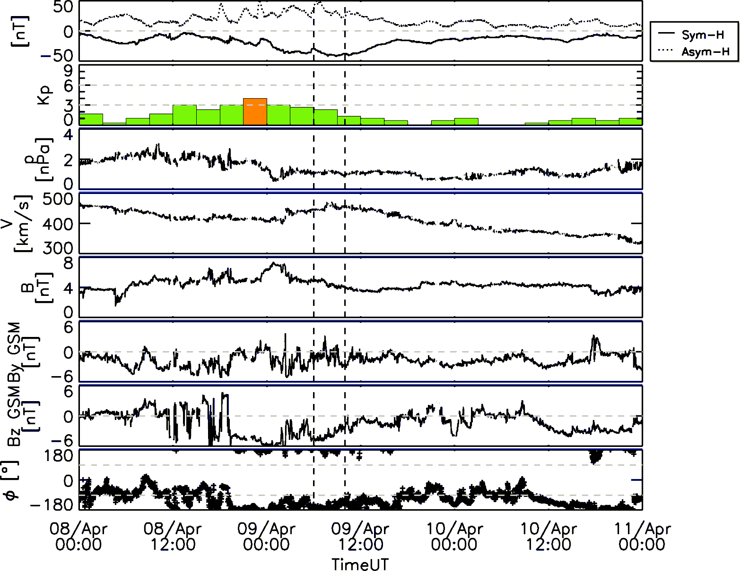
Observations
Solar Wind & Geomagn. Activity
L. B. N. Clausen (Space@VT)
Large-Scale SAPS Observations
SD Workshop, 2011

Slide 4
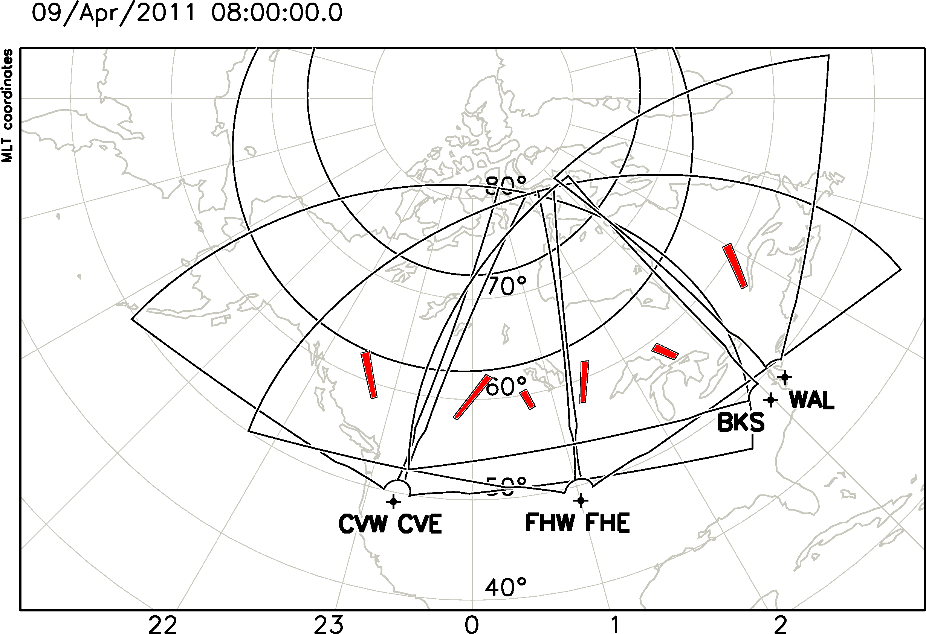
Observations
Overview
L. B. N. Clausen (Space@VT)
Large-Scale SAPS Observations
SD Workshop, 2011

Slide 5
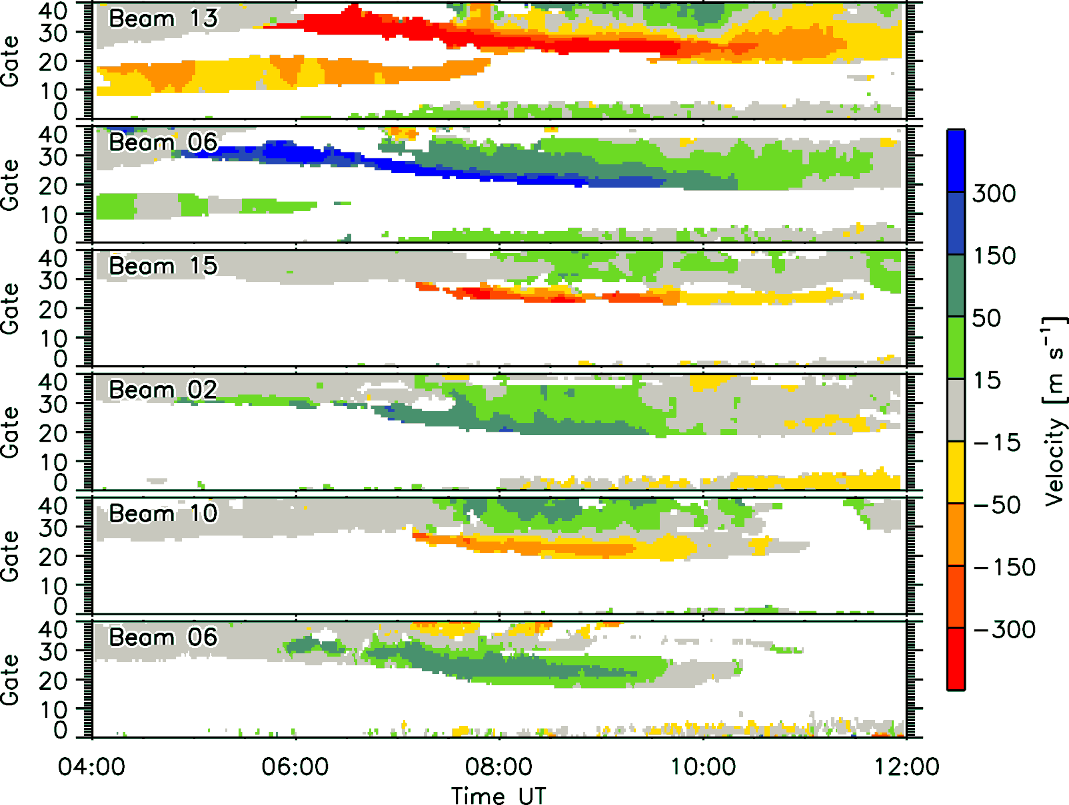
Observations
Velocity data
L. B. N. Clausen (Space@VT)
Large-Scale SAPS Observations
SD Workshop, 2011

Slide 6
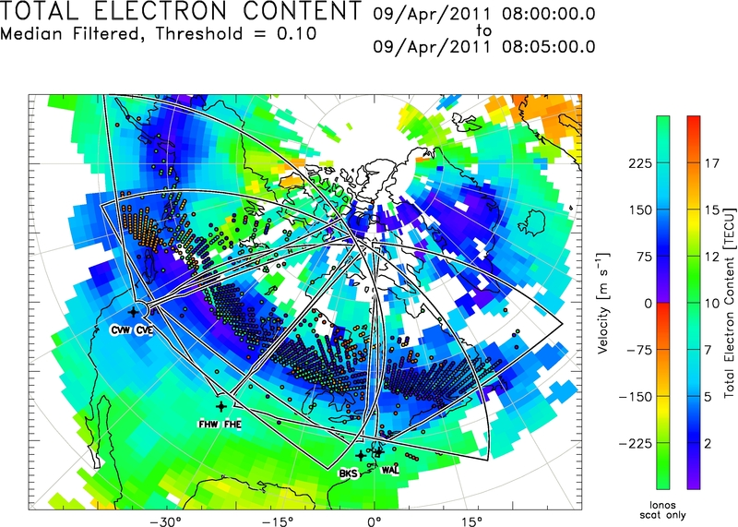
Observations
TEC Comparisson
L. B. N. Clausen (Space@VT)
Large-Scale SAPS Observations
SD Workshop, 2011

Slide 7
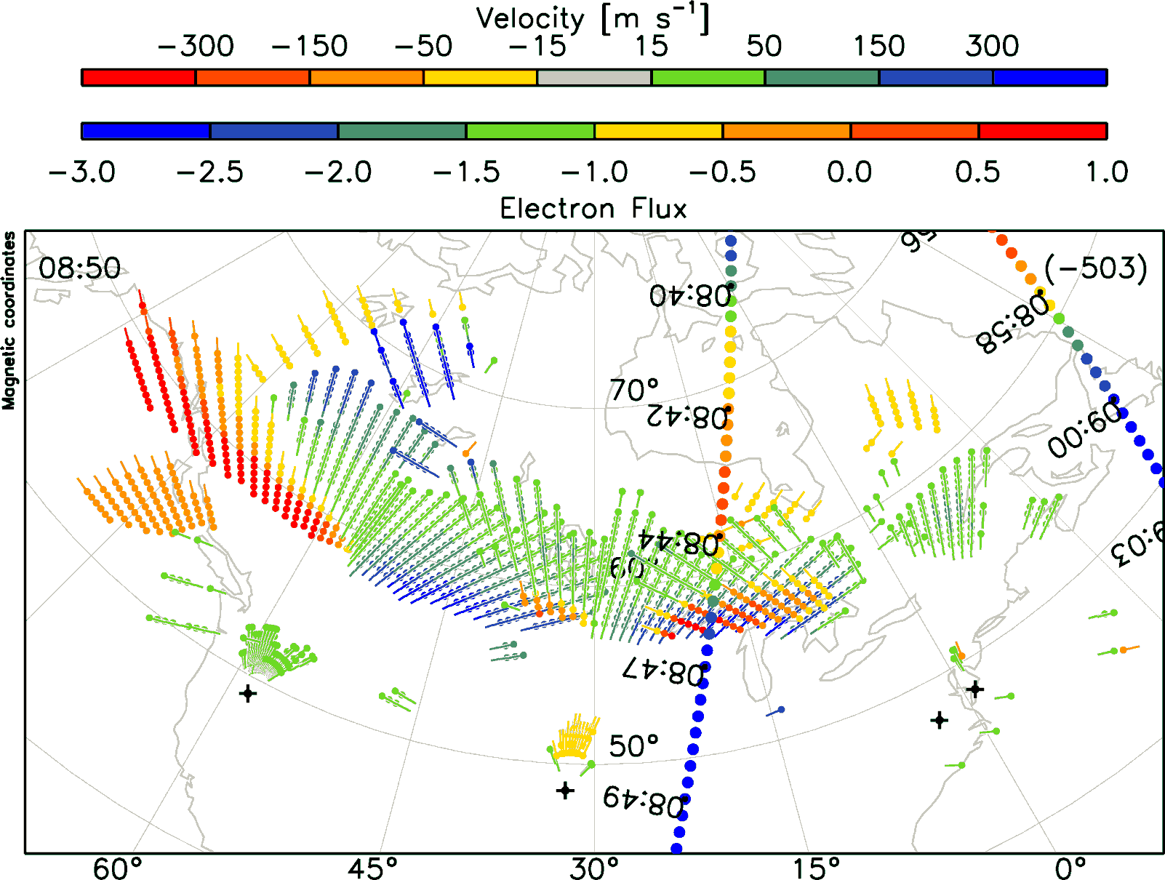
Observations
Overview
L. B. N. Clausen (Space@VT)
Large-Scale SAPS Observations
SD Workshop, 2011

Slide 8
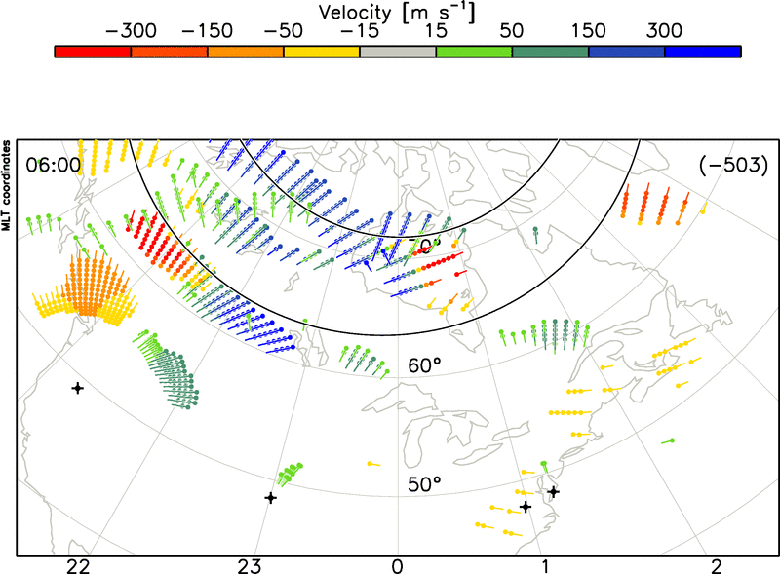
Observations
SAPS vs. Time
L. B. N. Clausen (Space@VT)
Large-Scale SAPS Observations
SD Workshop, 2011

Slide 9
Observations
SAPS vs. Time
L. B. N. Clausen (Space@VT)
Large-Scale SAPS Observations
SD Workshop, 2011

Slide 10
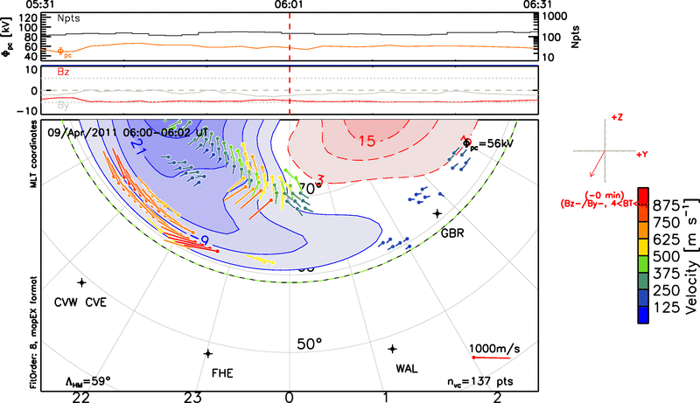
Observations
Potential vs. Time
L. B. N. Clausen (Space@VT)
Large-Scale SAPS Observations
SD Workshop, 2011

Slide 11
Observations
Potential vs. Time
L. B. N. Clausen (Space@VT)
Large-Scale SAPS Observations
SD Workshop, 2011

Slide 12
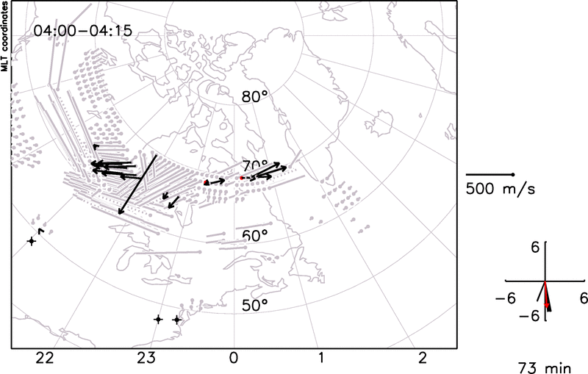
Section Name
Subsection name
Slide Title
L. B. N. Clausen (Space@VT)
Large-Scale SAPS Observations
SD Workshop, 2011

Slide 13
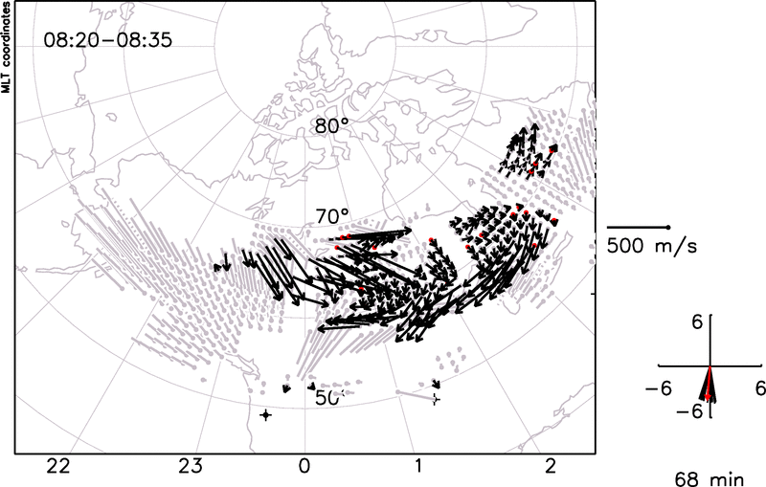
Observations
2D Merged Velocities
L. B. N. Clausen (Space@VT)
Large-Scale SAPS Observations
SD Workshop, 2011

Slide 14
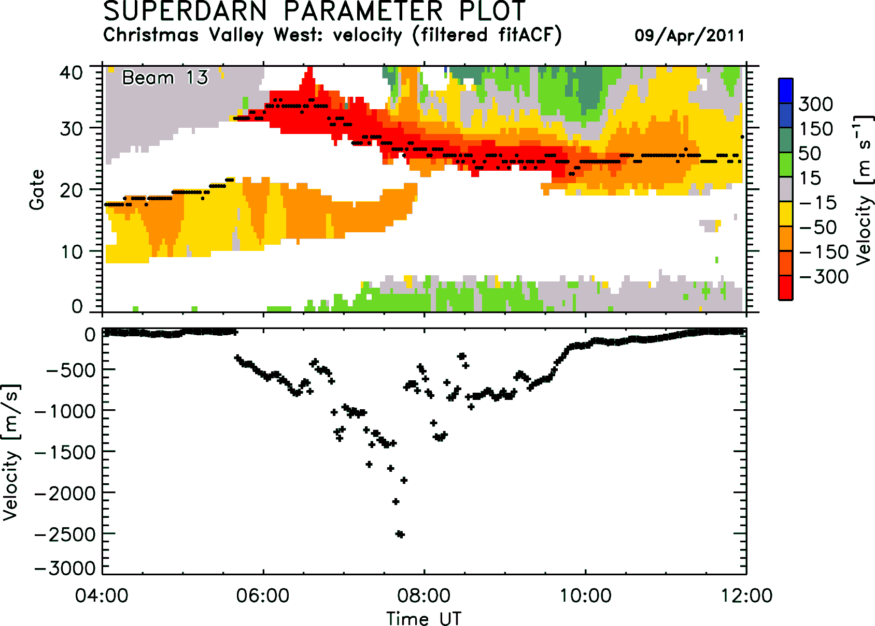
Observations
Velocity Trace
L. B. N. Clausen (Space@VT)
Large-Scale SAPS Observations
SD Workshop, 2011

Slide 15
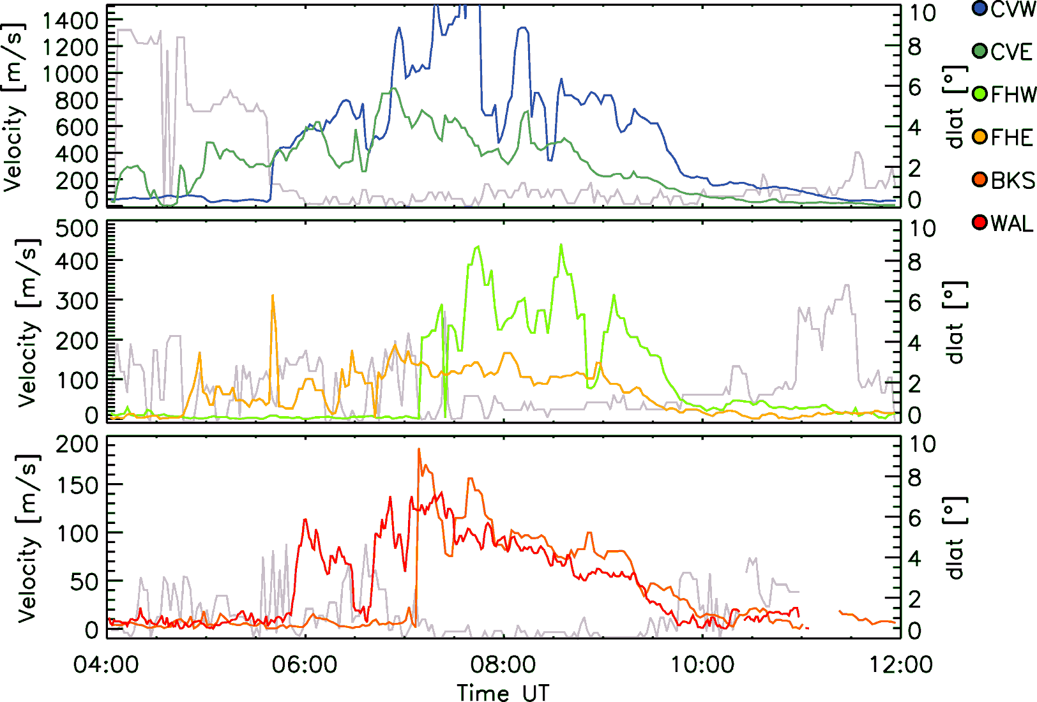
Observations
Longitudinal Variation
L. B. N. Clausen (Space@VT)
Large-Scale SAPS Observations
SD Workshop, 2011

Slide 16
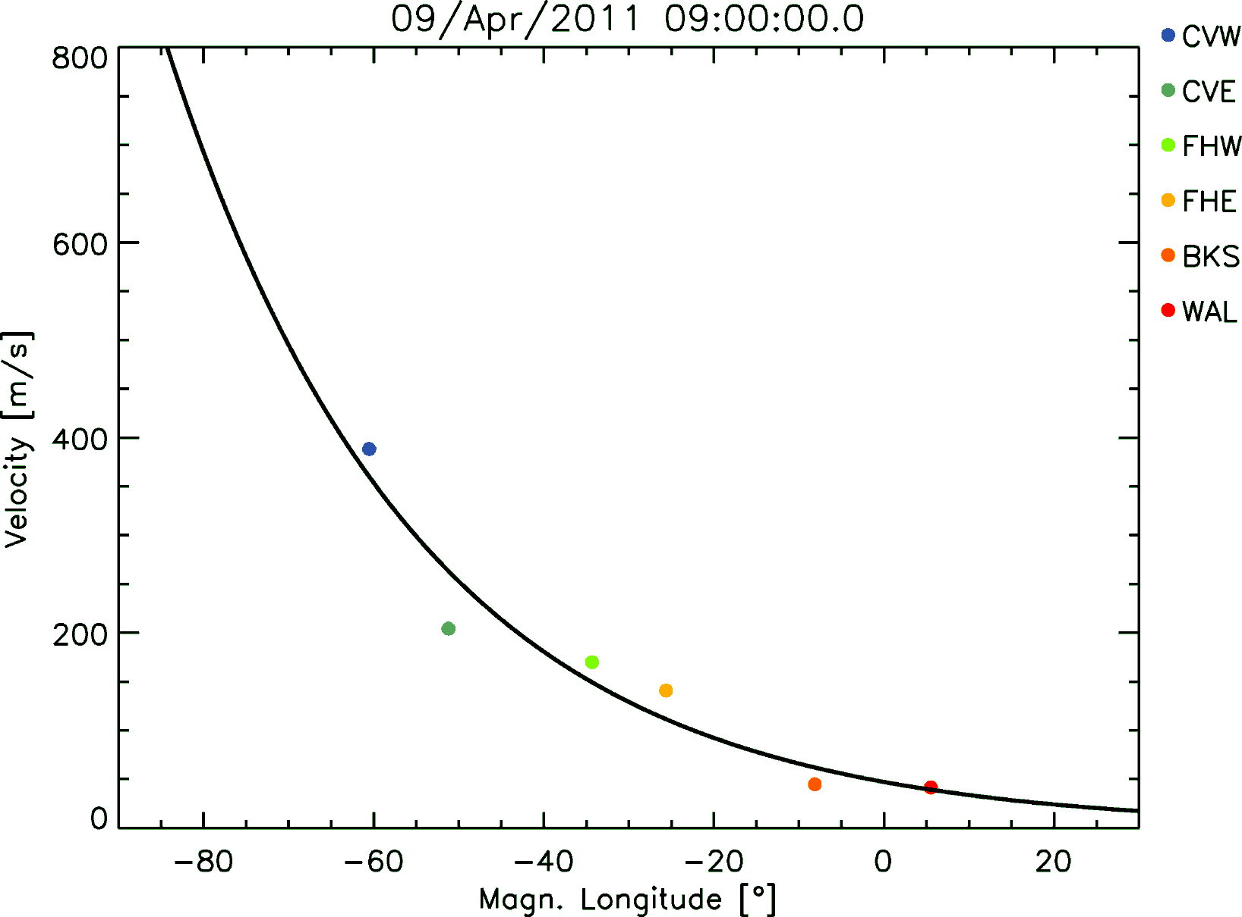
Observations
Longitudinal Variation
L. B. N. Clausen (Space@VT)
Large-Scale SAPS Observations
SD Workshop, 2011

Slide 17
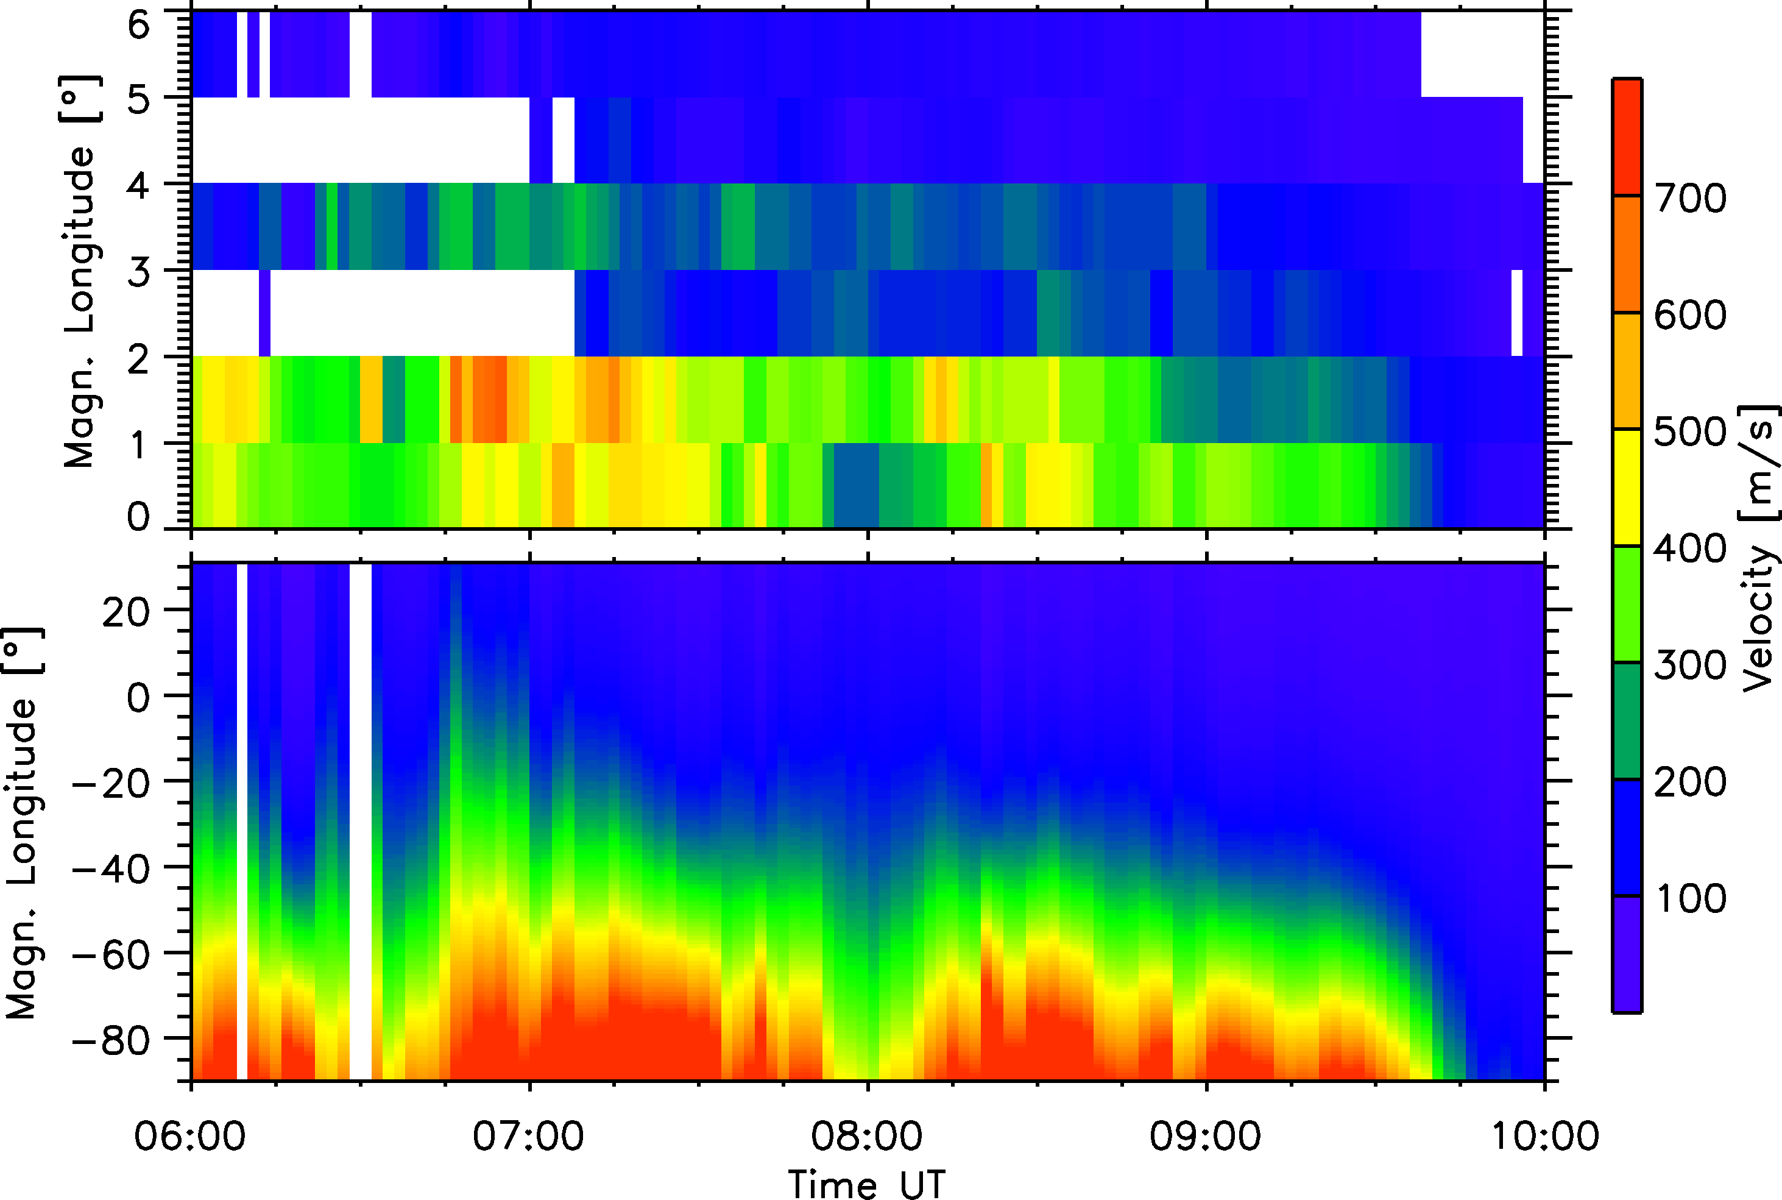
Observations
Slide Title
L. B. N. Clausen (Space@VT)
Large-Scale SAPS Observations
SD Workshop, 2011

Slide 18
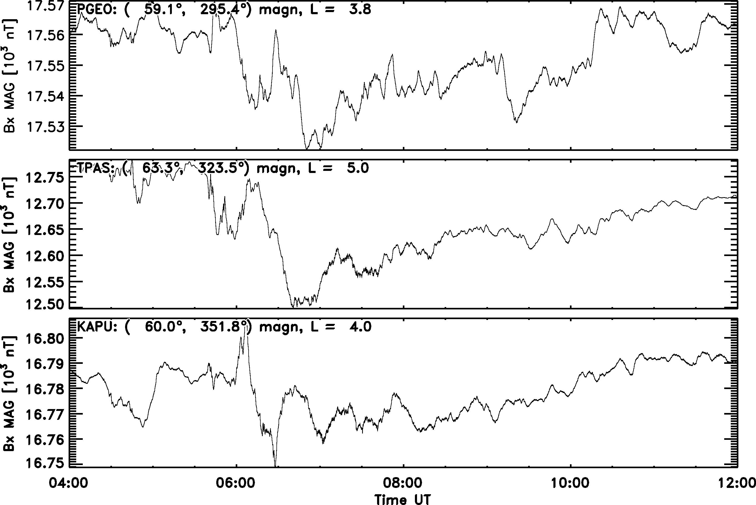
Section Name
Subsection name
Slide Title
Name (Space@VT)
Short Presentation Title
Meeting, Date

Slide 19
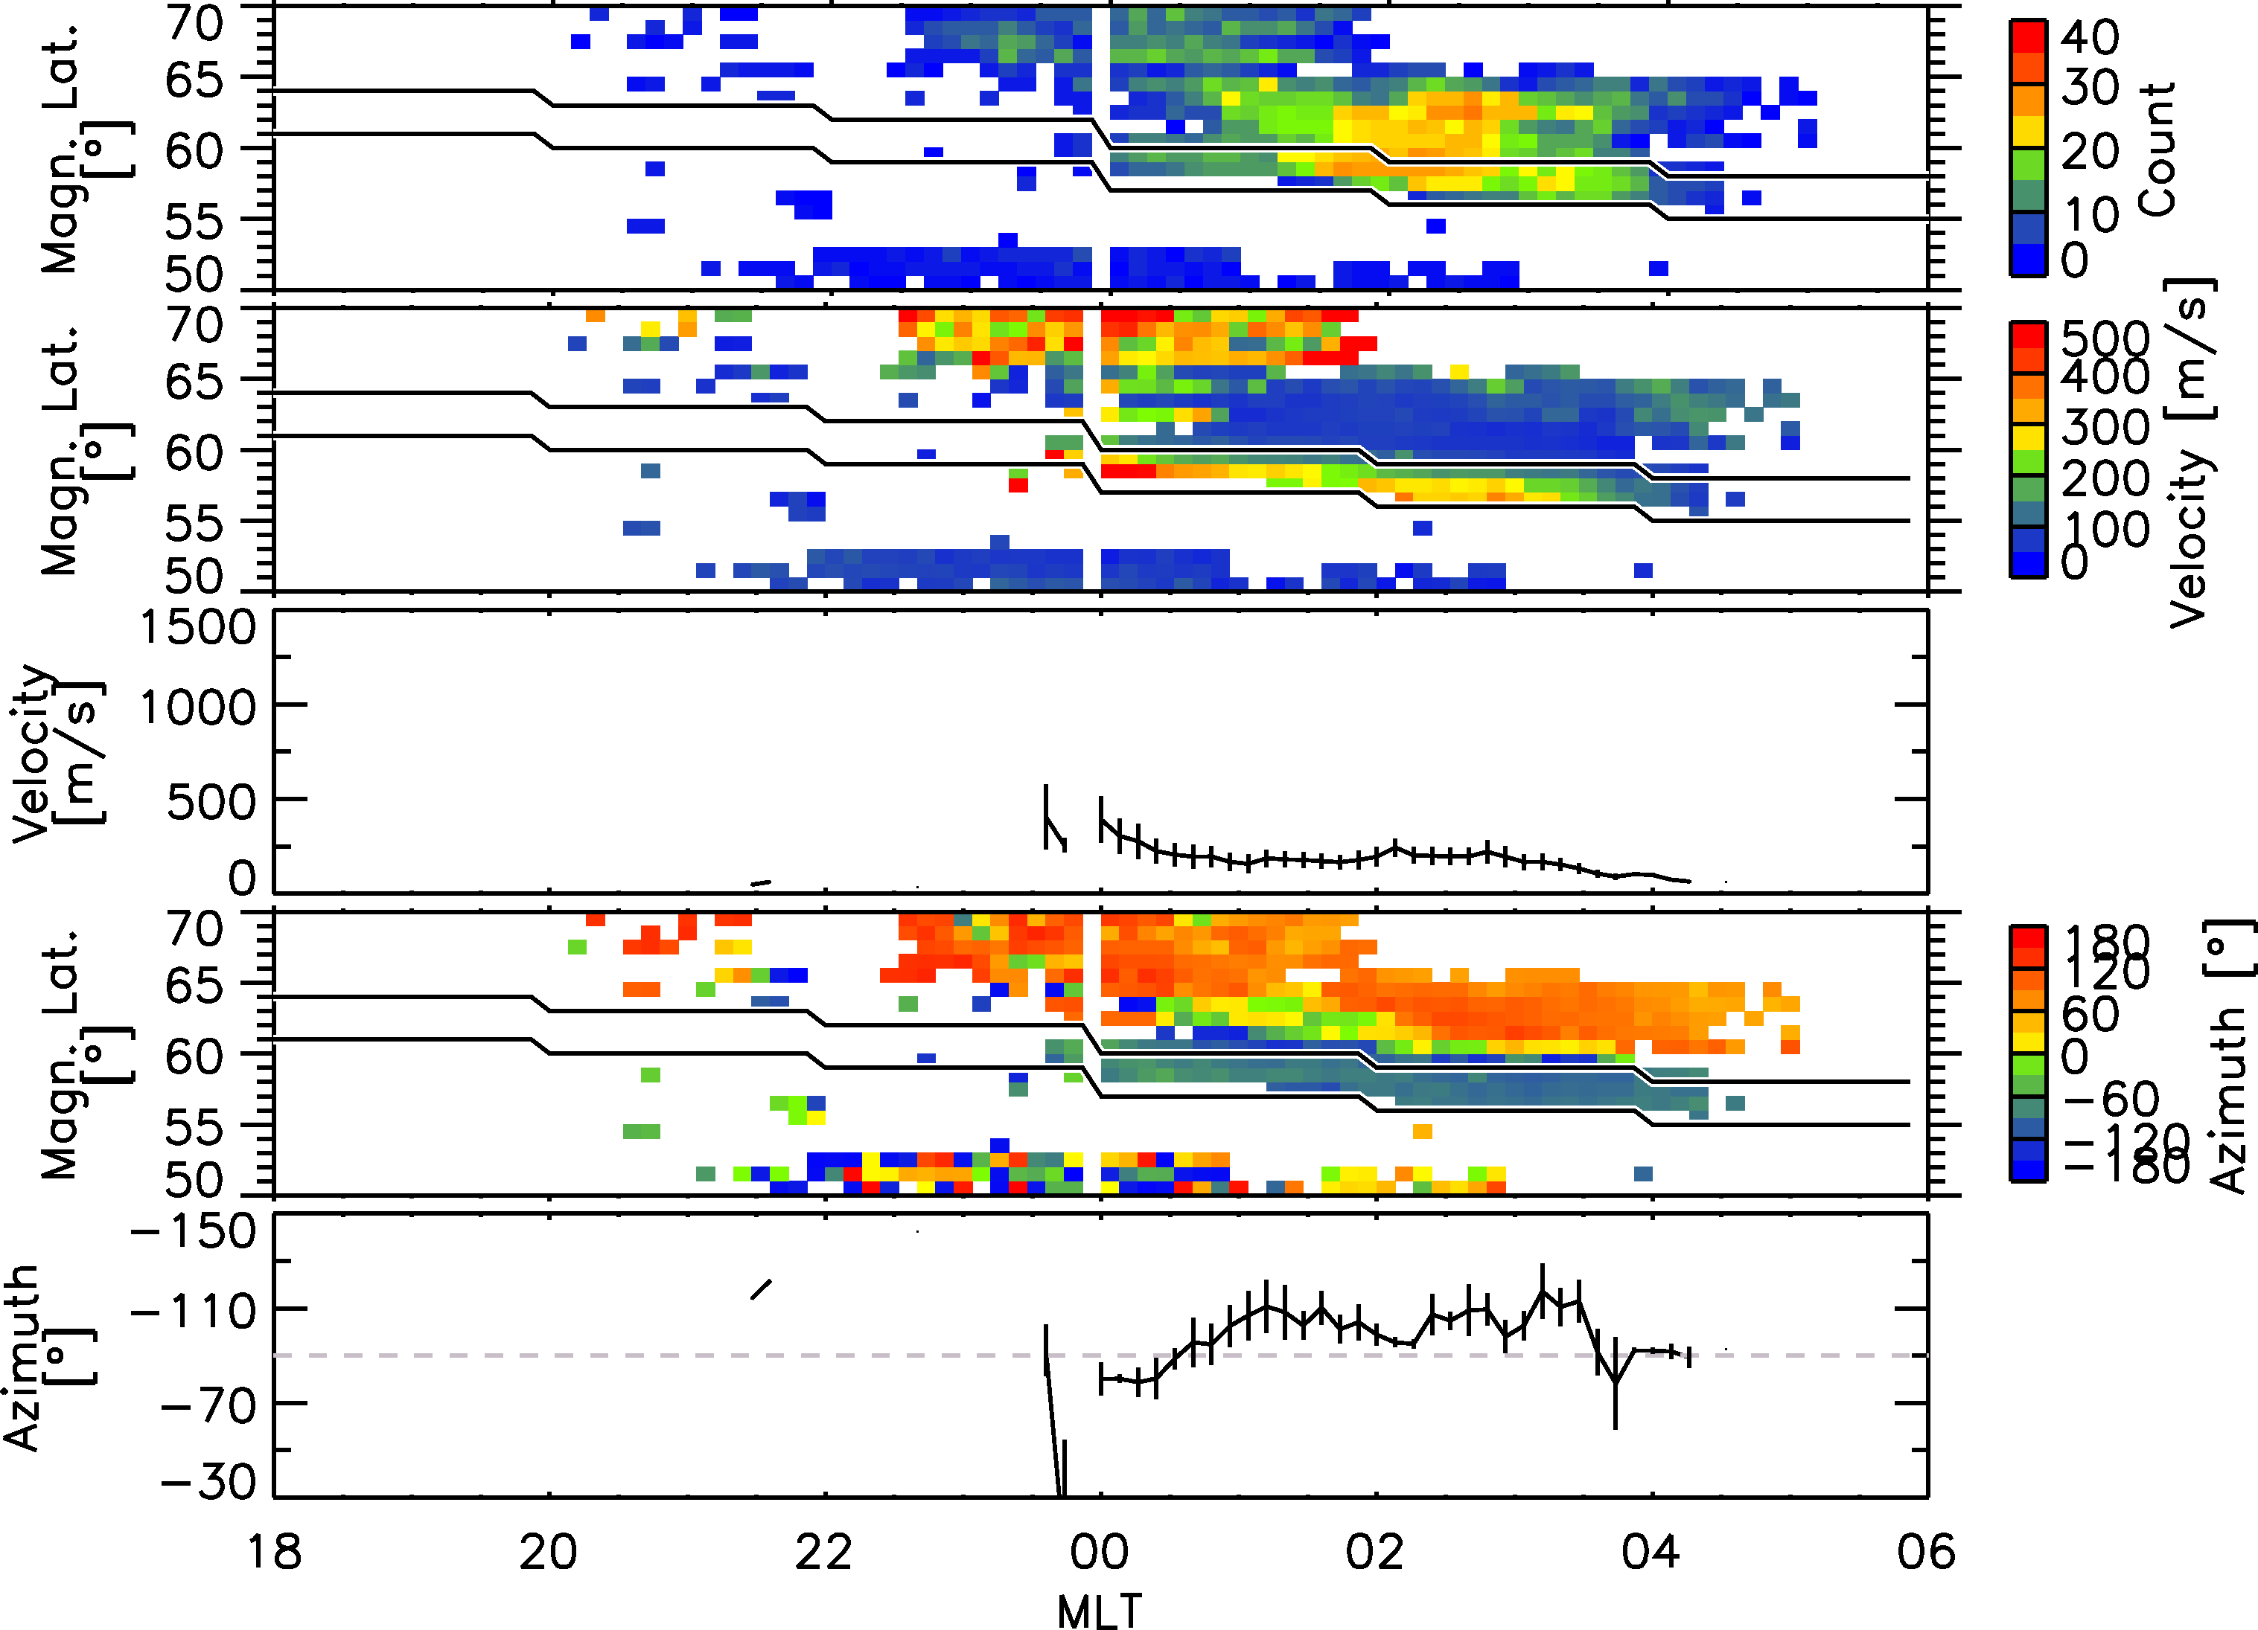
Section Name
Subsection name
Slide Title
Name (Space@VT)
Short Presentation Title
Meeting, Date

Slide 20
Conclusions
Conclusions
The (expanding) chain of mid-latitude radars provides an excellent opportunity to study and disentangle the longitudinal and temporal variation of sub-auroral phenomena like SAPS
L. B. N. Clausen (Space@VT)
Large-Scale SAPS Observations
SD Workshop, 2011

Slide 21
Section Name
Subsection name
Slide Title
Name (Space@VT)
Short Presentation Title
Meeting, Date

Slide 22
Section Name
Subsection name
Slide Title
Name (Space@VT)
Short Presentation Title
Meeting, Date

Slide 23
Section Name
Subsection name
Slide Title
Name (Space@VT)
Short Presentation Title
Meeting, Date

